Slide 1








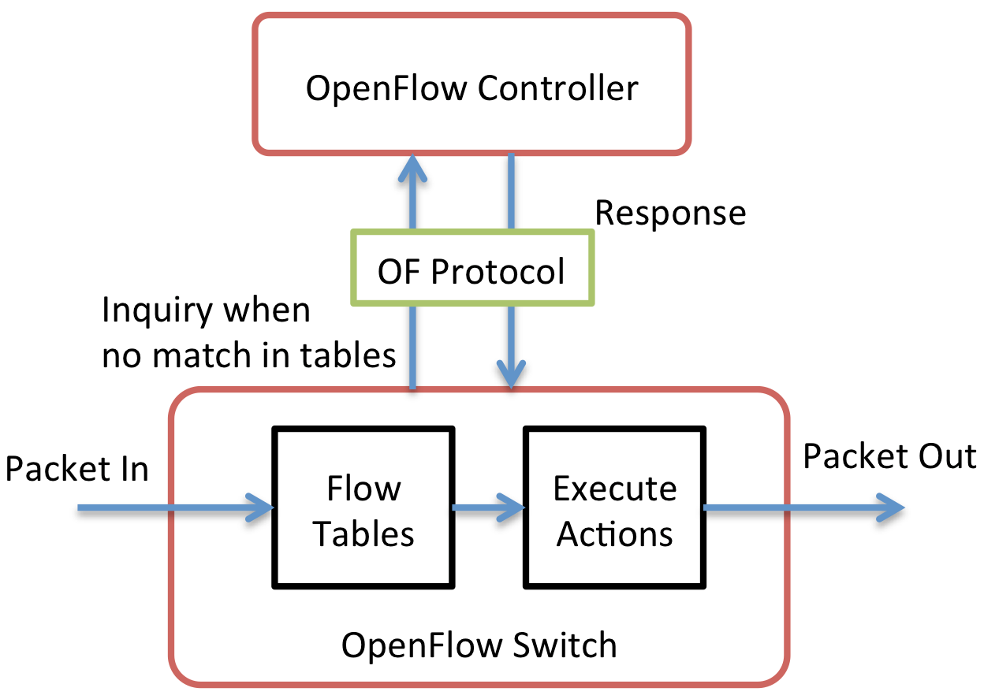
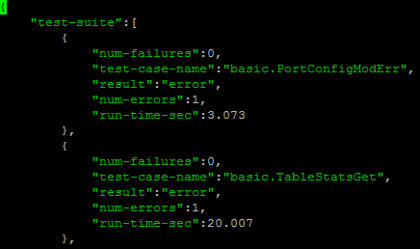

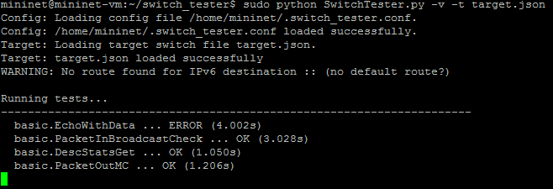
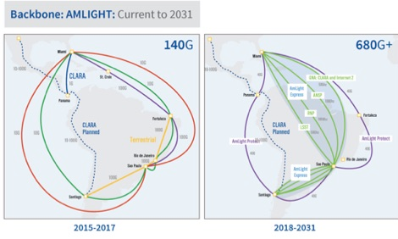
School of Computing & Information Sciences
Senior Project, 2016, Fall
Learning OpenFlow SDN for Research and Experimentation - Version 1.0
Student: Jahkell Lazarre, Florida International University
Mentors: Jeronimo Bezerra, CIARA FIU; Vasilka Chergarova, CIARA FIU;
Mohsen Taheri, Florida International University
Instructor: Masoud Sadjadi, Florida International University
Problem
Research in the field of Software Defined Networking (SDN) is largely unaware of several restrictions encountered when deploying a proposed architecture on real devices. OpenFlow (OF) implementation documentation has limitations when working with switches from different vendors. Different versions of OF may also give unpredictable errors and in some cases crash the switch. AmLight is a production network and cannot have such errors.
Current System
No automated way to test switches
No single human-readable “report”
Network engineer must scan verbose OFTest output and manually record results
Hundreds of XML output files
No way to test switch against application profile
Requirements
Create SDN validation environment
Runnable on Mininet VM
Capture OFTest output
Generate JSON and CSV reports
Definition of application profile
Pass or fail depending on profile
Runnable on real switches
System Design
Network engineer (end-user) starts the switch to be tested
Network engineer starts SwitchTester
SwitchTester runs OFTest
OFTest sends and receives messages to and from switch
OFTest outputs results
SwitchTester generates report and validates switch
Network Engineer
SwitchTester
Starts
Solution
Develop automated solution in Python to test OpenFlow network configurations
Produce reports using OFTest and Ryu
The solution will be implemented in the AmLight testing methodology
Runs
Starts
OFTest
TargetSwitch
Sends / Receives OpenFlow Message
Object Design
Implementation
Python 2.7 on Mininet VM / Ubuntu Linux Distro
Tested switch using OpenFlow 1.0 specifications
Load configuration
Run OFTest as subprocess
Redirect OFTest’s STDERR to file
Parse XML output with Python module xmlrunner
Generate JSON and CSV reports
Validate switch against application profile
CoreTester acts as an abstract switch tester
Exposes core functionality to OFTTester
Loads various configurations
OFTTester runs OFTest, communicating with it via pipes
Repository read and written to by OFTTester and CoreTester
SwitchTester
Runs
Reads / Writes
CoreTester
Repository
Imports
Reads / Writes
OFTTester
OFTest
Runs
Verification
Unit and integration tests primarily done using a custom OFTest Python script which runs a virtual switch.
Purpose: To test correctness of generated CSV report given an application profile.
Precondition: The applicaiton profile has the expected test cases specified in the profile’s compatibility list.
The NAP data center in Downtown, Miami where testing of real switches took place.
An OpenFlow controller and switch.
Expected Result:
basic.PacketOut,OK
basic.DescStatsGet,OK
basic.PacketInBroadcastCheck,ERROR
basic.EchoWithData,ERROR
Actual Result:
basic.PacketOut,OK
basic.DescStatsGet,OK
basic.PacketInBroadcastCheck,ERROR
basic.EchoWithData,ERROR
Status: PASSED
Example Unit Test
An instance of SwitchTester running.
The AmLight backbone.
Summary
The AmLight Team has developed a custom methodology for testing to unveil several additional limits and anomaly in a range of commercial OpenFlow switches. This work is considered an important milestone assessing the gap between research results and their applicability. The AmLight testing methodology can be applied to additional devices along with custom tests to consider additional functions and better estimate flow table lookup performance. The VIP Team developed an automated solution in Python for testing OpenFlow network configurations and producing reports using open-source testing frameworks like OFTest.
Acknowledgement
The material presented in this poster is based upon the work done by Jahkell Lazarre and Steven Lyons. The project was supported by our mentors, Jeronimo Bezerra, Vasilka Chergarova, and Mohsen Taheri.
Notes:
‹#›

